Slide 1


Semester 472 - 2026, 1447
Course CS315 Algorithms Analysis and Design
Analysis of Algorithms
Lecture 1
Prof. Dr Mohammed Al-Hagery
Athar alwabel
Supervisordr@yahoo.com
aa.alwabel@qu.edu.sa

Slide 2

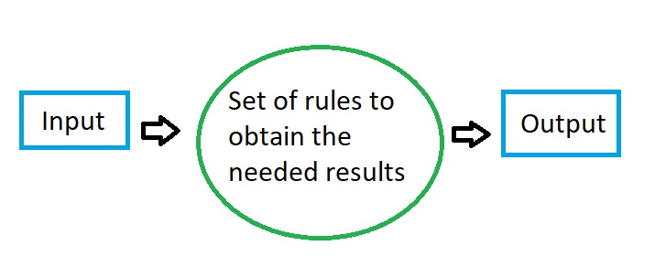
Analysis of Algorithms
An algorithm is a step-by-step procedure for
solving a problem in a finite amount of time

Slide 3
Running Time (§1.1)
Most algorithms transform input objects into output objects.
The running time of an algorithm typically grows with the input size.
Average case time is often difficult to determine.
We focus on the worst case running time.
  Easier to analyze
  Crucial to applications such as games, finance and robotics

Slide 4
Worst Case Analysis (Mostly used)
In the worst-case analysis, we calculate the upper bound on the running time of an algorithm.
We must know the case that causes a maximum number of operations to be executed.
For Linear Search, the worst case happens when the element to be searched (x) is not present in the array.
  Example:
    Consider performing insertion sort on N numbers on a random access machine. The best-case for the algorithm is when the numbers are already sorted, which takes O(n) steps to perform the task.
    - However, the input in the worst-case for the algorithm is when the numbers are reverse sorted and it takes O(n²) steps to sort them; therefore the worst-case time-complexity of insertion sort is of O(n²)

Slide 5
Experimental Studies (§ 1.6)
- Write a program implementing the algorithm.
- Run the program with inputs of varying size and composition.
- Use a method like System.currentTimeMillis() to get an accurate measure of the actual running time.
- Plot the results.

Slide 6
Limitations of Experiments
- It is necessary to implement the algorithm, which may be difficult.
- Results may not be indicative of the running time on other inputs not included in the experiment.
- In order to compare two algorithms, the same hardware and software environments must be used and the same inputs.

Slide 7
Theoretical Analysis
- Algorithms uses a high-level description of the algorithm instead of an implementation
- Characterizes running time as a function of the input size, n.
- Takes into account all possible inputs.
- Theoretical analysis allows us to evaluate the speed of an algorithm independent of the hardware/software environment.

Slide 8
Pseudocode (§1.1)
- High-level description of an algorithm
- More structured than English prose
- Less detailed than a program.
- Preferred notation for describing algorithms
- Hides program design issues.
Example: find max element of an array
Algorithm arrayMax(A, n)
Input array A of n integers
Output maximum element of A
currentMax ← A[0]
for i ← 1 to n − 1 do
if A[i] > currentMax then
currentMax ← A[i]
return currentMax

Slide 9
Pseudocode Details
- Control flow
  if … then … [else …]
  while … do …
  repeat … until …
  for … do …
  Indentation replaces braces
- Method declaration
  Algorithm method (arg [, arg…])
  Input …
  Output …
- Method call
  var.method (arg [, arg…])
- Return value
  return expression
- Expressions
  Assignment
  (like = in Java)
  Equality testing
  (like == in Java)
  n² Superscripts and other mathematical formatting allowed

Slide 10
The Random Access Machine (RAM) Model
A CPU
A potentially unbounded bank of memory cells, each of which can hold an arbitrary number or character
2
1
0
Memory cells are numbered and accessing any cell in memory takes unit time.

Slide 11
Primitive Operations
- Basic computations performed by an algorithm
- Identifiable in pseudocode.
- Largely independent from the programming language.
- Exact definition not important (we will see why? later)
- Assumed to take a constant amount of time in the RAM model.
Examples:
  - Evaluating an expression
  - Assigning a value to a variable
  - Indexing into an array.
  - Calling a method
  - Returning from a method.

Slide 12
Counting Primitive Operations (§1.1)
By checking or inspecting the pseudocode, we can determine the maximum number of primitive operations executed by an algorithm, as a function of the input size. See the 1st text book page 10
Algorithm arrayMax(A, n)
currentMax ← A[0]
for i ←1 to n − 1 d
if A[i] > currentMax the
currentMax ← A[i]
{ increment counter i }
return currentMax
# operations
2
//i:=1, loop n-1, cond if i=n-1 1 + n
2(n − 1)
2(n − 1)
2(n − 1)
1
Total =7n − 2

Slide 13
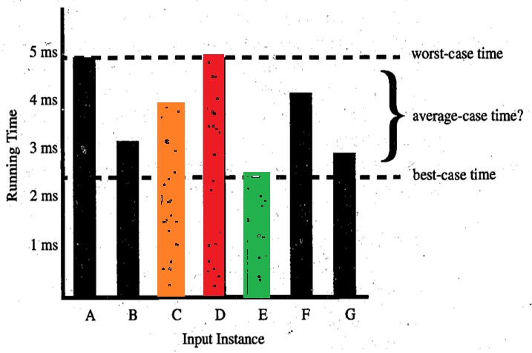
The 3 scenarios of algorithms behavior

Slide 14
Estimating Running Time
Algorithm arrayMax executes 7n − 2 primitive operations in the worst case.
If we Define:
  a = Time taken by the fastest primitive operation
  b = Time taken by the slowest primitive operation
Let T(n) be worst-case time of arrayMax. Then
a (7n − 2) ≤ T(n) ≤ b(7n − 2)
Hence, the running time T(n) is bounded by two linear functions.

Slide 15
Growth Rate of Running Time
Changing the hardware/ software environment
  - Affects T(n) by a constant factor, but
  - Does not alter/change the growth rate of T(n)
The linear growth rate of the running time T(n) is an essential property of algorithm arrayMax

Slide 16
Growth Rates
Growth rates of functions:
  Linear ≈ n
  Quadratic ≈ n²
  Cubic ≈ n³
Does the growth depend on the HW?
It depends on What?

Slide 17
Constant Factors
 The growth rate is not affected by
  constant factors or
  lower-order terms
 Examples
  10²n + 10⁵ is a linear function
  10⁵n² + 10⁸n is a quadratic function

Slide 18
Big-Oh Notation (§1.2)
Definition: Big O Notation (O): Describes an upper bound on the time or space complexity. It represents the worst-case scenario and is used to express the maximum amount of time or space an algorithm will require.
Given functions f(n) and g(n), we say that f(n) is O(g(n)) if there are positive constants
c and n₀ such that
f(n) ≤ cg(n) for n ≥ n₀
Example: 2n + 10 is O(n)
  2n + 10 ≤ cn
  (c − 2) n ≥ 10
  n ≥ 10/(c − 2)
  Pick c = 3 and n₀ = 10

Slide 19
Big-Oh Example
Example: the function n² is not O(n)
  n² ≤ cn
  n ≤ c
  The above inequality cannot be satisfied because c must be a constant
  Refers back to text book

Slide 20
More Big-Oh Examples
7n-2
  7n-2 is O(n),
  need c > 0 and n₀ ≥ 1 such that 7n-2 ≤ c•n for n ≥ n₀
  this is true for c = 7 and n₀ = 1
3n³ + 20n² + 5
  3n³ + 20n² + 5 is O(n³)
  need c > 0 and n₀ ≥ 1 such that 3n³ + 20n² + 5 ≤ c•n³ for n ≥ n₀
  this is true for c = 4 and n₀ = 21
3 log n + log log n
  3 log n + log log n is O(log n)
  need c > 0 and n₀ ≥ 1 such that 3 log n + log log n ≤ c•log n for n ≥ n₀
  this is true for c = 4 and n₀ = 2

Slide 21
Big-Oh and Growth Rate
- The big-Oh notation gives an upper bound on the growth rate of a function
- The statement “f(n) is O(g(n))” means that the growth rate of f(n) is no more than the growth rate of g(n)
- We can use the big-Oh notation to rank functions according to their growth rate.
 | f(n) is O(g(n)) | g(n) is O(f(n))
g(n) grows more | Yes | No
f(n) grows more | No | Yes
Same growth | Yes | Yes

Slide 22
Big-Oh Rules
If f(n) is a polynomial of degree d, then f(n) is O(n^{d}), i.e.,
Drop lower-order terms
  Drop constant factors
Use the smallest possible class of functions
  Say “2n is O(n)” instead of “2n is O(n²)”
Use the simplest expression of the class
  Say “3n + 5 is O(n)” instead of “3n + 5 is O(3n)”
متعددة الحدود

Slide 23
Asymptotic Algorithm Analysis
-The asymptotic analysis of an algorithm determines the running time in big-Oh
notation
- To perform the asymptotic analysis.
  We find the worst-case number of primitive operations executed as a function of the
  input size, We express this function with big-Oh notation
- Example:
  We determine that algorithm arrayMax executes at most 7n − 1 primitive operations
  We say that algorithm arrayMax “runs in O(n) time”
Since constant factors and lower-order terms are eventually dropped anyhow,
we can disregard/Igno them when counting primitive operations (means the 7 and 1).
In summary, Asymptotic Algorithm Analysis helps in understanding the
efficiency of algorithms by describing their performance in terms of growth rates,
providing a clear comparison and evaluation of algorithms based on their scalability
with large inputs.

Slide 24
Computing Prefix Averages
- We further illustrate asymptotic analysis with two algorithms for prefix averages
- The i-th prefix average of an array X is average of the first (i + 1) elements of X:
A[i] = (X[0] + X[1] + … + X[i])/(i+1)
- Computing the array A of prefix averages of another array X has applications to financial analysis.

Slide 25
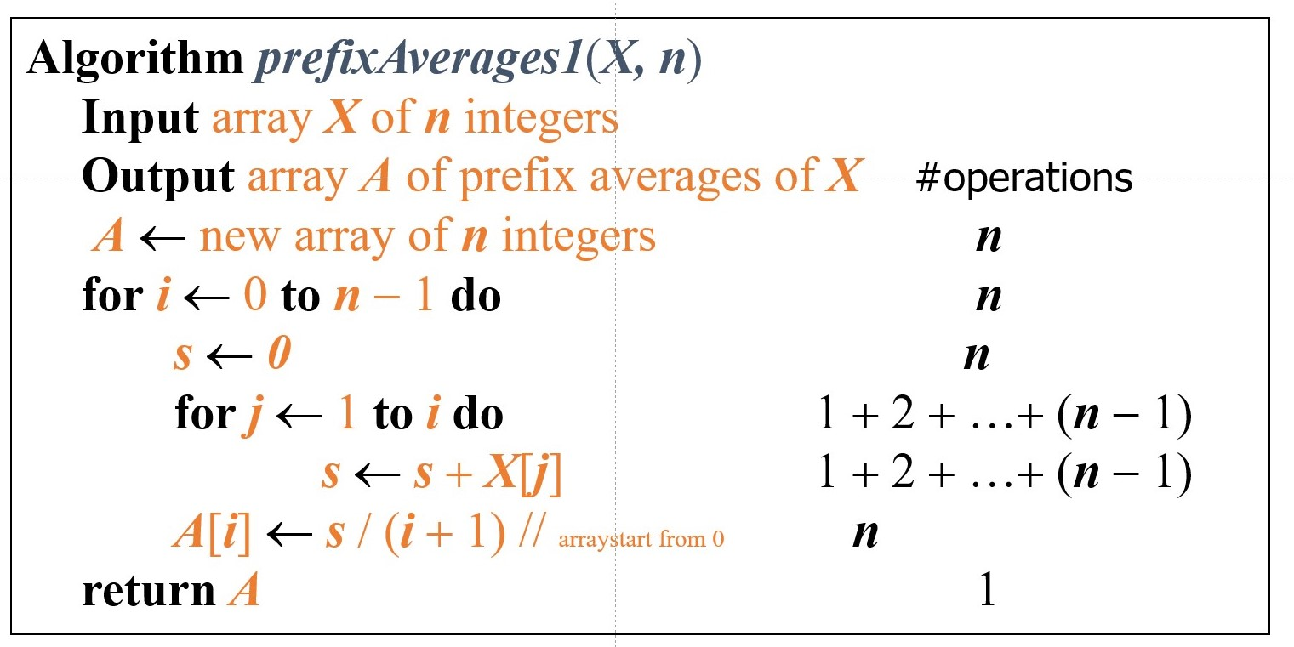
Prefix Averages (Quadratic)
The following algorithm computes prefix averages in quadratic time by applying the definition see page 32

Slide 26
Arithmetic Progression
- The running time of prefixAverages1 is
O(1 + 2 + …+ n)
- The sum of the first n integers is n(n + 1) / 2
  There is a simple visual proof of this fact
- Thus, algorithm prefixAverages1 runs in O(n²) time for inner loop
details are in page 32

Slide 27

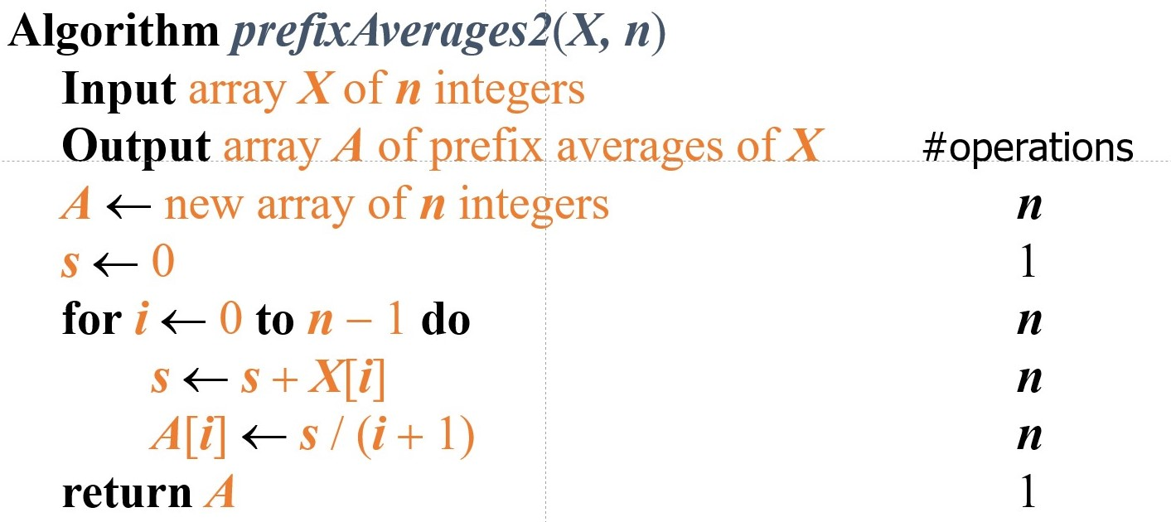
Prefix Averages (Linear)
The following algorithm computes prefix averages in linear time by keeping a running sum
Algorithm prefixAverages2 runs in O(n) time is much better than the time of prefix 1

Slide 28
Math you need to Review
- Summations (Sec. 1.3.1)
- Logarithms and Exponents (Sec. 1.3.2)
- Proof techniques (Sec. 1.3.3)
- Basic probability (Sec. 1.3.4)
properties of logarithms:
  log_{b}(xy) = log_{b}x + log_{b}y
  log_{b} (x/y) = log_{b}x - log_{b}y
  log_{b}xª = alog_{b}x
  log_{b}a = log_{x}a/log_{x}b
properties of exponentials:
  a^{(b+c)} = a^{b}a ^{c}
  a^{bc} = (a^{b})^{c}
  a^{b} /a^{c} = a^{(b-c)}
  b = a ^{log}_{a}^{b}
  b^{c} = a ^{c*log}_{a}^{b}

Slide 29
Relatives of Big-Oh
- big-Omega
  f(n) is Ω(g(n)) if there is a constant c > 0
  and an integer constant n₀ ≥ 1 such that
  f(n) ≥ c•g(n) for n ≥ n₀
- big-Theta
  f(n) is Θ(g(n)) if there are constants c’ > 0 and c’’ > 0
  and an integer constant n₀ ≥ 1 such that c’•g(n) ≤ f(n) ≤ c’’•g(n) for n ≥ n₀
- little-oh
  f(n) is o(g(n)) if, for any constant c > 0, there is an integer constant n₀ ≥ 0 such that f(n) ≤ c•g(n) for n ≥ n₀
- little-omega
  f(n) is ω(g(n)) if, for any constant c > 0, there is an integer constant n₀ ≥ 0 such that f(n) ≥ c•g(n) for n ≥ n₀

Slide 30
Asymptotic Notation
Big-Oh
  f(n) is O(g(n)) if f(n) is asymptotically less than or equal to g(n)
big-Omega
  f(n) is Ω(g(n)) if f(n) is asymptotically greater than or equal to g(n)
big-Theta
  f(n) is Θ(g(n)) if f(n) is asymptotically equal to g(n)
little-oh
  f(n) is o(g(n)) if f(n) is asymptotically strictly less than g(n)
little-omega
  f(n) is ω(g(n)) if is asymptotically strictly greater than g(n)

Slide 31
The End ..
This lecture was from
Algorithm Design: Foundations, Analysis, and Internet Examples
By Michael T. Goodrich, Roberto Tamassia
chapter 1

